Slide 1
2.6: Strings
Playing around with words

Slide 2
Strings
Strings in Java are instances of the java.lang.String class that hold sequences of characters (a, b, c, $, etc.)
String s = “Hello, world!”;
String instance
s
0 | 1 | 2 | 3 | 4 | 5 | 6 | 7 | 8 | 9 | 10 | 11 | 12
H | e | l | l | o | , |  | w | o | r | l | d | !

Slide 3


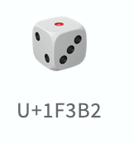


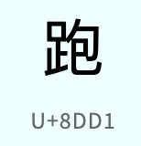
Strings are made up of chars
The char data type is a single 16-bit Unicode character.
It ranges from'\u0000' (or 0) to '\uffff' (65,535, or 2¹⁶-1)
(\u is the backslash escape sequence for a Unicode code point in hexadecimal.)
Unicode covers all the characters for most writing systems of the world, modern and ancient (including proposals for Elvish and Klingon). 144,697 total characters today. To the right is just the “Basic Latin” code points.

Slide 4
Creating Strings
String is a class, so you can construct them with the new operator.
String s = new String(“Hello, world!”);
Strings can also be constructed using string literals:
String s = “Hello, world!”;
These do… mostly the same thing…

Slide 5
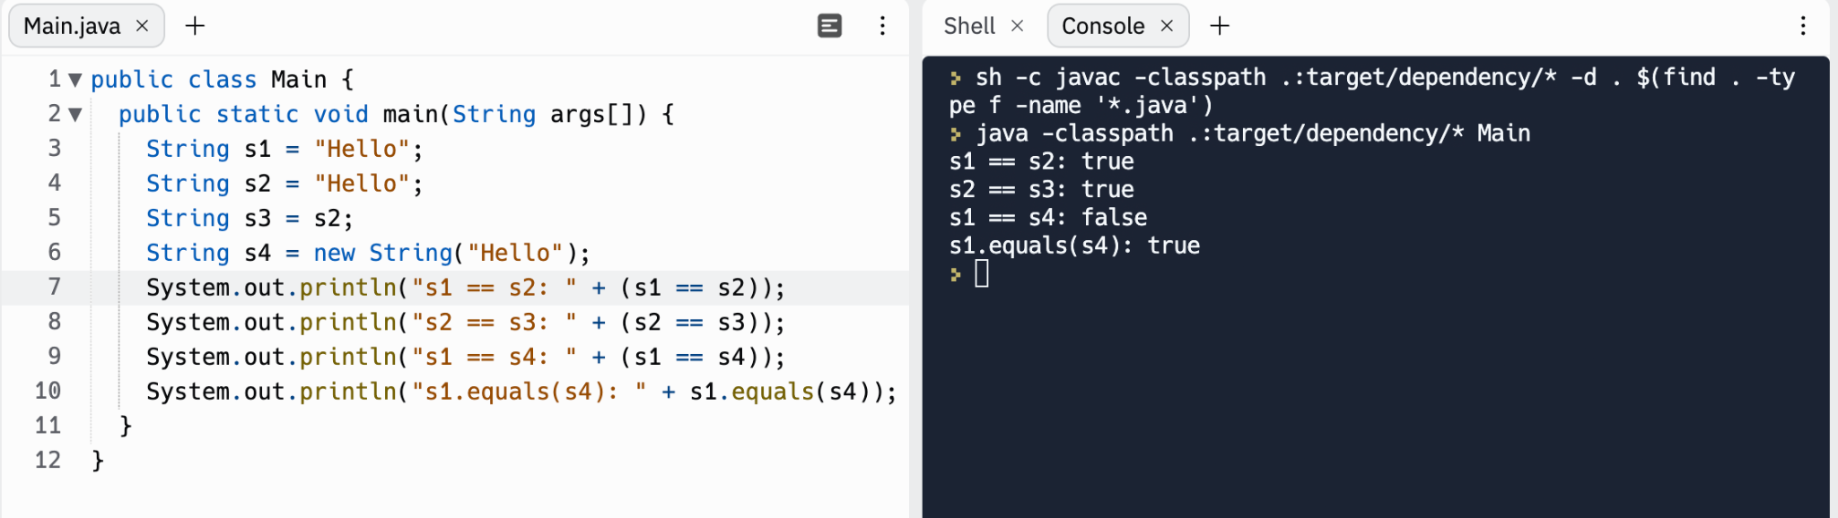

Slide 6
s1
s2
s3
s4
String literal “Hello”
Java Language Standard 15.29:
Constant expressions of type String are always "interned" so as to share unique instances, using the method String.intern.
new String(“Hello”)

Slide 7
String comparison in Java
In many other languages, like JavaScript and Python, you can use the == operator to compare strings for equality.
In Java, the == operator compares object references, not what’s in the referenced objects!
s1.equals(s2) is almost always what you want, not s1 == s2

Slide 8
String concatenation
Strings can be appended to each other to create a new string using the + or += operator. This is also called concatenation.
In the expression x + y, x and y are the operands and + is the operator.
If x or y is a String, the other operand will be converted to String. That’s why
System.out.println("Temp: " + 43 + " Frozen: " + false);
works. What does this print out?
System.out.println("Age: " + 1 + 2);

Slide 9
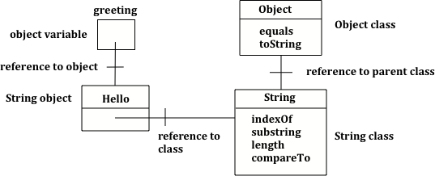
Strings are Objects
Java classes have a parent class. The parent class of java.lang.String is java.lang.Object, which is the “ancestor” of all Java classes.
There is also a Class class! Every class has a getClass method which returns its Class.
Java programs can inspect their own classes and even change them in some ways. This is called reflection or metaprogramming.

Slide 10
2.7: String Methods
Playing around with words

Slide 11
String Methods
These are some of the most commonly used methods by programmers in industry.
Definitions for these will be provided to you in the AP CS Exam Java Reference Sheet.
(Even professional Java developers still look these up from time to time!)
It's still important to understand these methods though, as you'll be using them a lot.

Slide 12

String Methods
int length() method returns the number of characters in the string, including spaces and special characters like punctuation.
String substring(int from, int to) method returns a new string with the characters in the current string starting with the character at the from index and ending at the character before the to index (if the to index is specified, and if not specified it will contain the rest of the string).
Remember: In Java, we always start counting from 0

Slide 13
String Methods
int indexOf(String str) method searches for the string str in the current string and returns the index of the beginning of str in the current string or -1 if it isn’t found.
int compareTo(String other) returns a negative value if the current string is less than the other string alphabetically, 0 if they have the same characters in the same order, and a positive value if the current string is greater than the other string alphabetically.
boolean equals(String other) returns true when the characters in the current string are the same as the ones in the other string. This method is inherited from the Object class, but is overridden which means that the String class has its own version of that method.

Slide 14
null
If you declare a String variable without initializing it, its value is null.
String s; ← Will contain null
Just like any other class, if you invoke a method of null, like s.length() here, Java will throw a NullPointerException.
null has its uses. It can represent the absence of a thing. For example, some people don’t have a middle name: class Person(String firstName, String middleName, String lastName) {...} Person person = new Person(“John”, null, “Middlenameless”);

Slide 15
Mutable vs Immutable
Mutable: CAN CHANGE, Immutable: CANNOT CHANGE
Strings are immutable. Any methods that seems to change a string actually just creates a copy of it, and returns the new version as its return value. String str1 = "Hello!"; // Print str1 in lower case? Will str1 change? str1.toLowerCase(); System.out.println("In lowercase: " + str1);

Slide 16
Why are strings immutable?
Immutability is a powerful concept in Computer Science. It can make it easier to reason about what a program does.
When you pass a String to a method, since Strings are immutable, you know that the method cannot change your String behind your back!
s += ", world!"; is really the same as s = s + ", world";
(but is stylistically better)
Many modern programming languages have immutable strings, such as Python and JavaScript. Some chose to have mutable strings, like Ruby.

Slide 17
Practice!
Repl.it : stringsMethods1

Slide 18
Practice!
Repl.it : stringsMethods2

